Slide 1
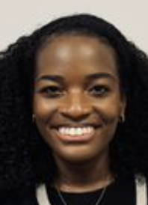
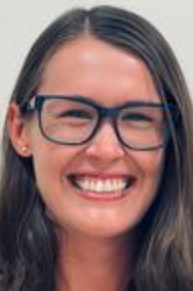
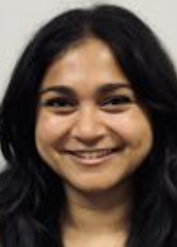
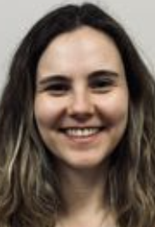
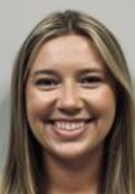
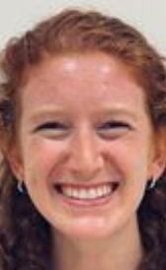
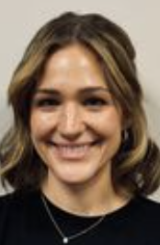
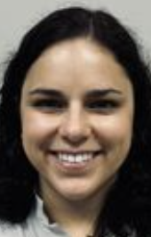
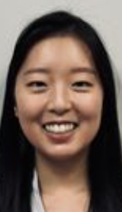
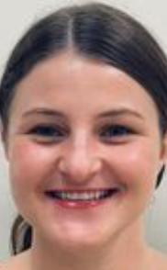
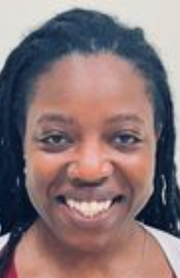
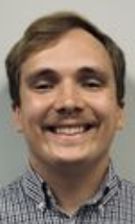
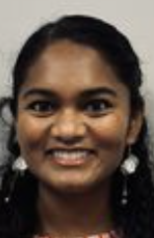
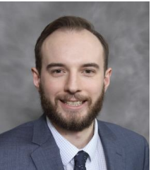
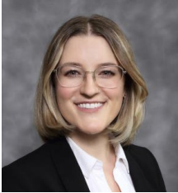
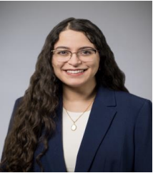
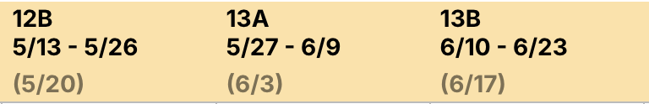
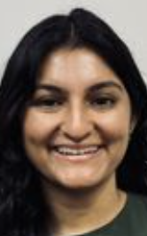
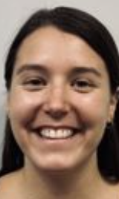
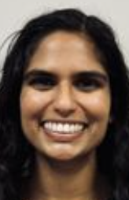

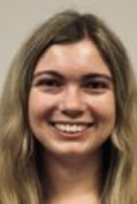
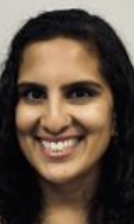

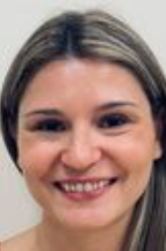
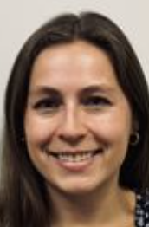
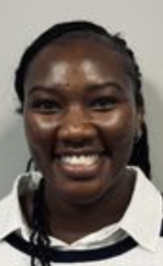
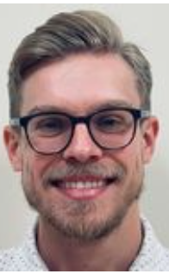
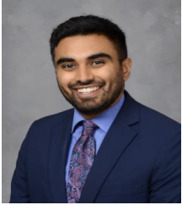
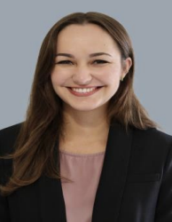
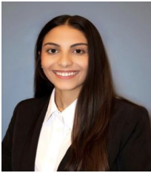
2025 JULY
AUG
SEPT
OCT
NOV
DEC
Shalini
Jayaweera
Simge
Acar
Alyssa
Kalsbeek
Emma
Office
Elisabeth
Hollembaek
Parr
Gabriela
Betancourt
Yunji
Kim
Cassandra
Mocek
Tiffany
Sims
Kiernan
Bloye
Swathi
Ganesh
Winter
Coverage
Candice
Wilson
Sierra
Blashock
10/20-11/14 (FM)
Clayton Vesperman
11/17-12/2 (FM)
Julia Thelen
12/15-1/9 (FM)
Monay Zayed
ADMIN CONTACT: PEDS RESIDENT = chiefs@bsd.uchicago.edu 773.702.7553
FM INTERN = MAranda@northshore.org 847.657.1840
2026 JAN
FEB
MAR
APR
MAY
JUNE
Sumana
Shashidhar
Kathleen
Coogan
Priya
Karkhanis
Eric
Casinelli
Samantha
Rodriguez
Meghana
Rao
Simone
Ymson
Maura
Knapp
Anna
Perry
Torie
Livingston
Swathi
Ganesh
Mark
Perkowski
1/12-2/6 (FM)
Eashan Kumar
2/9-3/6 (FM)
Eileen Vera
3/9-4/3 (FM)
Nora Kasis
ADMIN CONTACT FOR MS3 = dcroach@bsd.uchicago.edu 773/834-0497

Slide 2
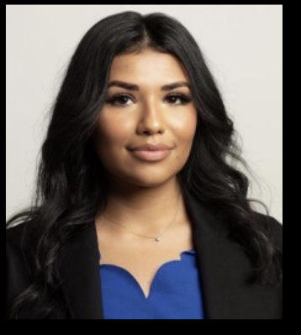
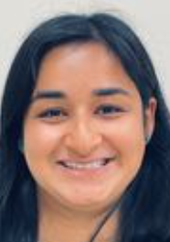
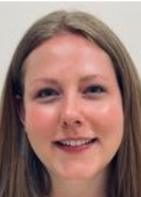
2025 JULY
AUG
SEPT
OCT
NOV
DEC
EVANSTON NURSERY RESIDENTS 2025-26
6/16-6/27
Alejandra
Corral
(Fam Med)
7/14-7/25
Eashan Kumar
(Fam Med)
7/23-8/5
Danica
Mathew
(PEDS)
8/11-8/22
Monay Zayed
(Fam Med)
8/20-9/2
Maura Knapp
(PEDS)
10/1-10/14
Cassie Mocek
(PEDS)
10/6-10/17
Nora Kasis
(Fam Med)
12/10-12/21
Sierra
Blashock
(PEDS)
12/15-12/26
Clayton
Vasperman
(Fam Med)
2026 JAN
FEB
MAR
APR
MAY
1/12-1/23
Julia Thelen
(Fam Med)
2/18-3/3
Emma
Office
(PEDS)
3/4-3/17
Samantha
Bailey
(PEDS)
4/20-5/1
Eileen Vera
(Fam Med)
ADMIN CONTACTS:
FAM MED = MAranda@northshore.org 847.657.1840
PEDS = chiefs@bsd.uchicago.edu 773.702.7553

Slide 3
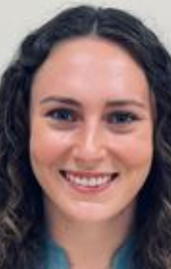
JULY
AUG
SEPT
OCT
NOV
DEC
EVANSTON AMBULATORY /HOSPITALIST FELLOWS / ELECTIVE
Amb Clinics:
Derm (Joyce) – CCHA M8-5, Wed 730-430
Neuro (Finkle)
GI (Cordova)
Endo (Drobac)
Allergy (Story)
Cards (Groner) – CCHA Tues
11/12-11/25
Lauren Anderson
UofC
HOSP Elective
JAN
FEB
MAR
APR
MAY
JUNE
6/10-6/23
Sierra
Blashock
UofC HOSP
Elective
5/13-5/26
Maura
Knapp
(EV AMB)
6/10-6/23
Anna
Perry
(EV AMB)
1/5-1/20
Samantha
Bailey
(EV AMB)
3/4-3/17
Gabriela
Betancourt
(EV AMB)
ADMIN: chiefs@bsd.uchicago.edu 773.702.7553
For Advocate: Steven.Marek@aah.org

Slide 4
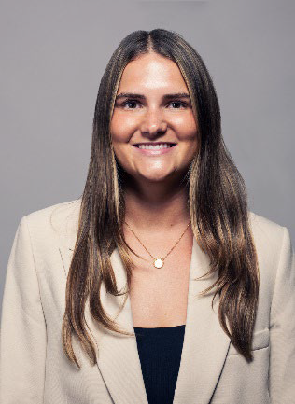
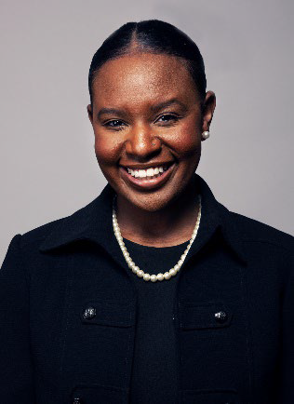
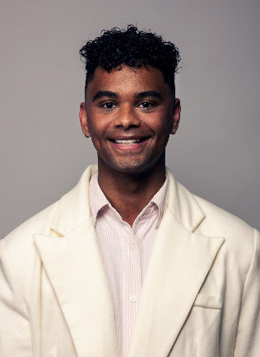
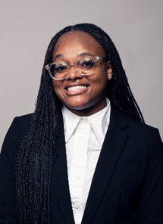
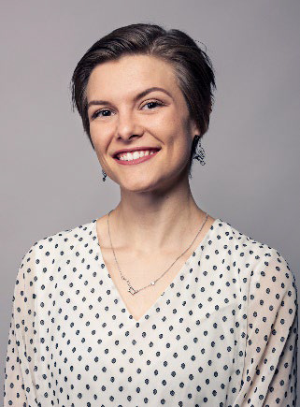
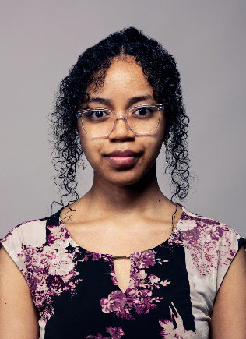
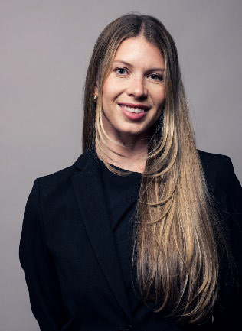
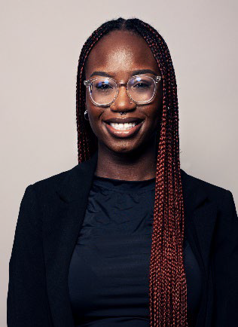
JULY
AUG
SEPT
OCT
NOV
DEC
HIGHLAND PARK PA STUDENTS 2025-26
Kirsten Kendler
5/27-7/1 (ISCU 6/5)
Kaitlyn Brown
7/7-8/13 (ISCU 7/17)
Justin Myers
8/18-9/24 (ISCU 8/28)
Antanisha Parks
9/29-11/5 (ISCU 10/9, Ev 10/6)
Kaylee Tatum
11/10-12/16 (ISCU 11/20, Ev 11/17)
JAN
FEB
MAR
APR
MAY
JUNE
Rashid Rakotondranoro
1/5-2/11 (ISCU 1/15, Ev 1/12)
Ryleigh Miller
2/16-3/25 (ISCU 2/26, Ev 2/23)
Yaa Mensah-Bonsu
4/6-5/8 (ISCU 4/16)
ADMIN CONTACT = nikkie.vargas@rosalindfranklin.edu 847-578-8727

Slide 5
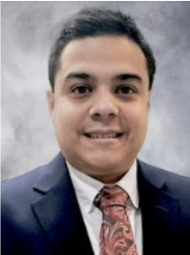
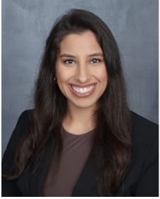
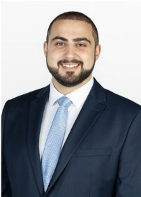
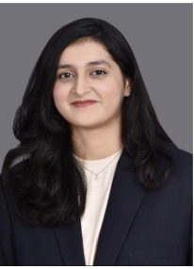
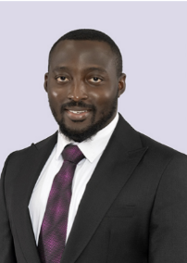
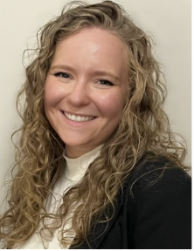
SWEDISH FM NURSERY RESIDENTS 2025-26
JULY
AUG
SEPT
OCT
NOV
DEC
Jesus
Rondon Tapia
8/25-9/7
Mecca Djahedian
10/20-11/2
Antonios
Diamantopoulos
11/17-11/30
JAN
FEB
MAR
APR
MAY
JUNE
Fizza
Mahmood
Olalekan
Ambibola
Catherine
Nagy
1/12-1/25
2/9-2/22
5/4-5/17
SWEDISH FM ADMIN CONTACT = JWagoner@schosp.org, (773) 878-8200 Ext. 1478

