Slide 1
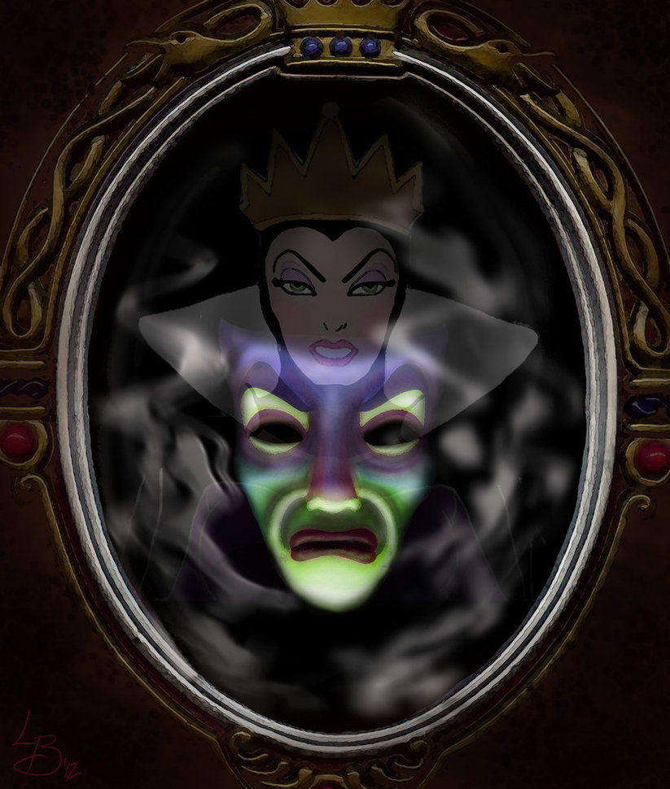
DOCTOR, DOCTOR
ON THE CALL
WHO IS THE
FAIREST
ONE OF ALL?
STEVE BACHTA MD

Slide 2



OBJECTIVES
ADVANCED APPLE PICKING: DIFFERENTIATING “SHAKING” VS “PLUCKING”
LEARN TO USE THE SCALES
OF SUSPICION TO AVOID
EATING POISON APPLES
APPRECIATE THAT OBSERVATION
CAN BE A CORE DIAGNOSTIC TOOL

Slide 3

There was a mother who brought her 3 week old child to the ED because he “stopped breathing”…
After ensuring the baby is currently breathing, what is your first question?

Slide 4
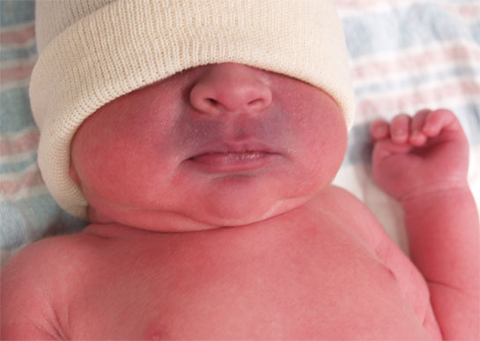
WHAT HAPPENED?
“I was putting my other six boys to bed and when I came to check on him, he wasn’t breathing and his mouth looked blue. I was worried and had to pick him up and blow in his mouth until he started breathing again – it took forever!”

Slide 5
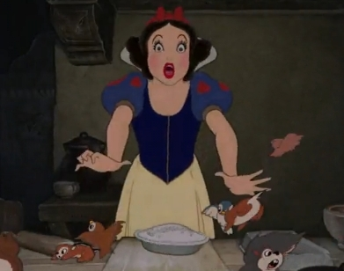
WHAT DOES
THIS
SOUND LIKE?
Old term:
ALTE – Apparent Life Threatening Event
an episode that is frightening to the observer and is characterized by some combination of apnea (central or obstructive), color change (cyanotic, pallid, erythematous or plethoric), change in muscle tone (usually diminished), and choking or gagging.

Slide 6
WHAT DOES
THIS
SOUND LIKE?
New term:
BRUE – Brief Resolved Unexplained Event
An event in a < 1yr old where the observer reports a sudden, brief (< 1min) and now resolved episode of at least 1 of following: 1) cyanosis or pallor, 2) absent, decreased or irregular breathing, 3) change in tone or 4) alerted level of responsiveness.

Slide 7
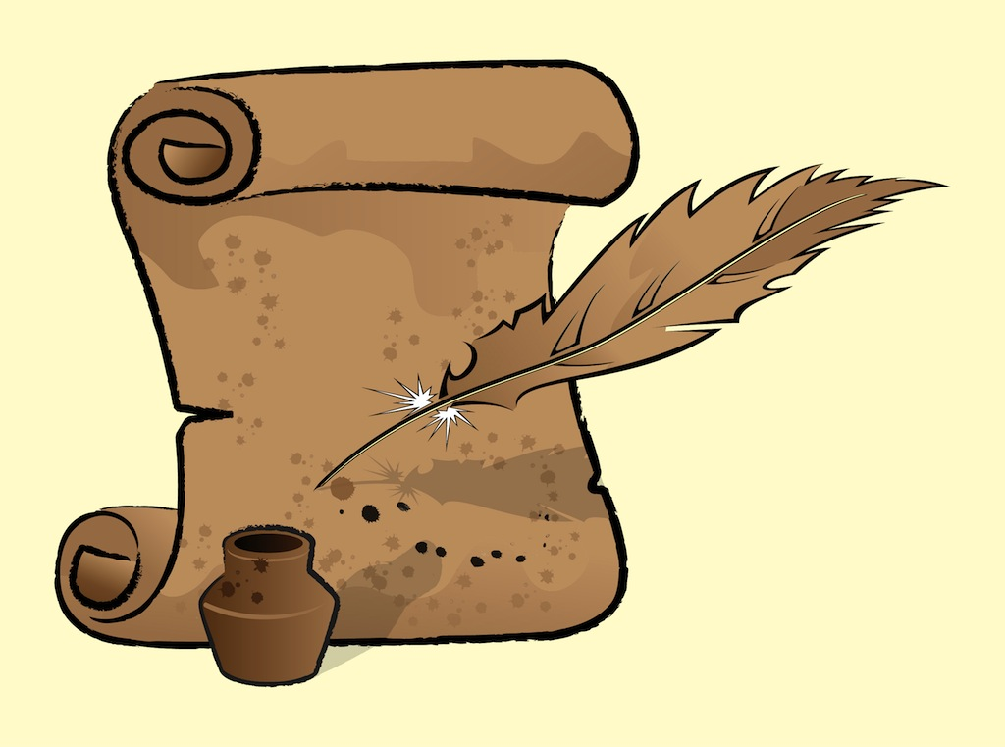
DIFFERENTIAL FOR BRUE BY SYSTEM

Slide 8
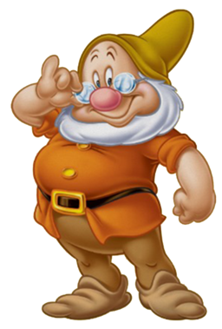
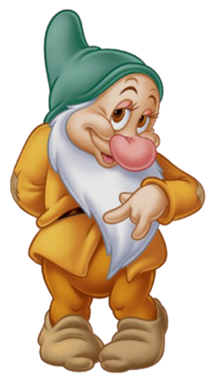
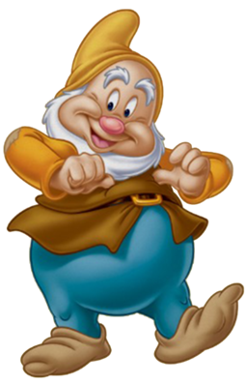
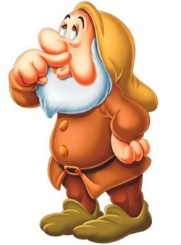
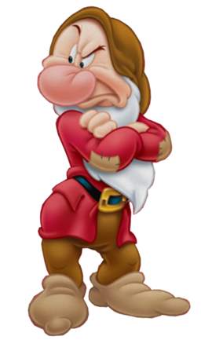
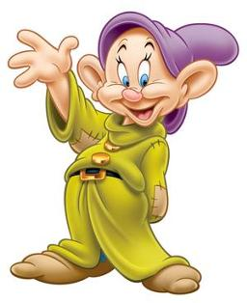
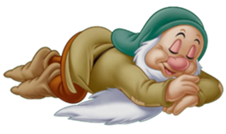
THE SEVEN DWARVES OF BRUE
SNEEZY
GRUMPY
DOC
BASHFUL
DOPEY
SLEEPY
HAPPY
RESPIRATORY
GI
ID
CARDS
NEURO
METABOLIC
IDIOPATHIC
(LOW RISK
BRUE)
GER
MALRO
INTUSS
RSV
PERTUSSIS
ASPIRATION
FOREIGN BODY
AIRWAY ANOMOLY
UTI
SEPSIS
MENINGITIS
ANEMIA
CHD
ARRYTHMIA
SZ
NAT
INBORN ERROR
TOX

Slide 9

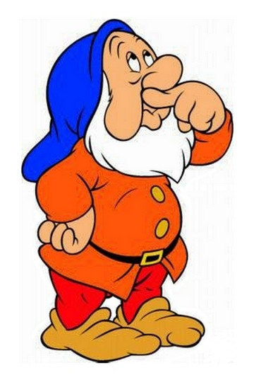
WHO IS THE FAIREST ONE OF ALL?
Fair = Marked by favoring conditions; likely; promising

Slide 10
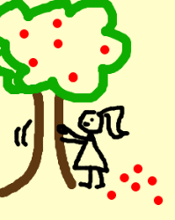

PICKING APPLES (EVIDENCE)
“SHAKE”
“PLUCK”
VS
“WHAT HAPPENED?”
“DID YOUR BABY START BREATHING
AGAIN ON HIS OWN?”

Slide 11
REVIEW OF HISTORY
Who observed the episode? Mom
What time did the episode occur?
8:00PM, last feed 7:30PM (currently 9:00PM)
What was infant doing right before the episode? Sleeping on his back
Did the infant fall or experience any trauma? No
Any runny nose, cough, vomiting, diarrhea, fever?
Occasional coughing and spitting up feeds x 2 days

Slide 12
REVIEW OF HISTORY
How was infant acting on day of event? Normal
How did infant look during episode?
Limp with blue lips, shook arms and legs when started breathing again
Any choking, eye rolling, blood or milk in mouth? No
How long did the episode last? Unsure -> act out
Did the episode stop on it’s own?
No, I blew in his mouth

Slide 13
REVIEW OF HISTORY
How has infant acted since? Normal self
Any medications the infant has taken or you have taken (if breastfeeding) in past 24hrs? No
Has infant ever experienced a similar episode? No
Does infant have any medical problems? No
Hx of birth: Full term, vaginal delivery, no complications
Anyone in family with SIDS, genetic, metabolic, cardiac, or neurologic condition or died of unknown cause? No

Slide 14
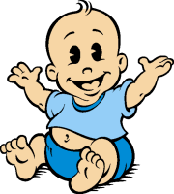
EXAM

Slide 15
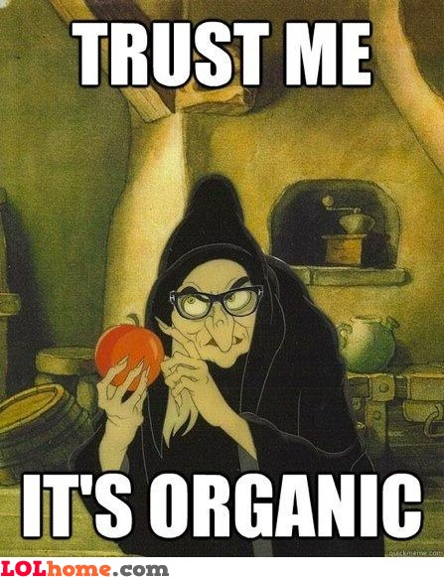
POISON APPLES

Slide 16
ASSESSMENT
3 WEEK OLD MALE WITH NO PMH PRESENTING WITH OCCASIONAL COUGH AND EMESIS AFTER FEEDS X 2 DAYS AND EPISODE OF PERIORAL CYANOSIS LASTING 30 SEC THIS EVENING REQUIRING RESCUE BREATHS TO RESOLVE. CURRENTLY WELL APPEARING WITH NORMAL VITAL SIGNS AND UNREMARKABLE EXAM.

Slide 17
HIGH RISK VS LOW RISK
Low Risk BRUE Criteria:
Age > 60 days
Gestational age > 32wks at birth, currently > 45wks
First BRUE
Duration of event < 1min
No CPR required by trained provider
No concerning physical exam findings

Slide 18
Low Risk BRUE Management
Educate about BRUE
Offer CPR training resources
May obtain pertussis testing and EKG
May briefly monitor pt with pulse ox
Need not obtain additional testing/workup or admit patient soley for monitoring
Arrange followup within 24 hours

Slide 19
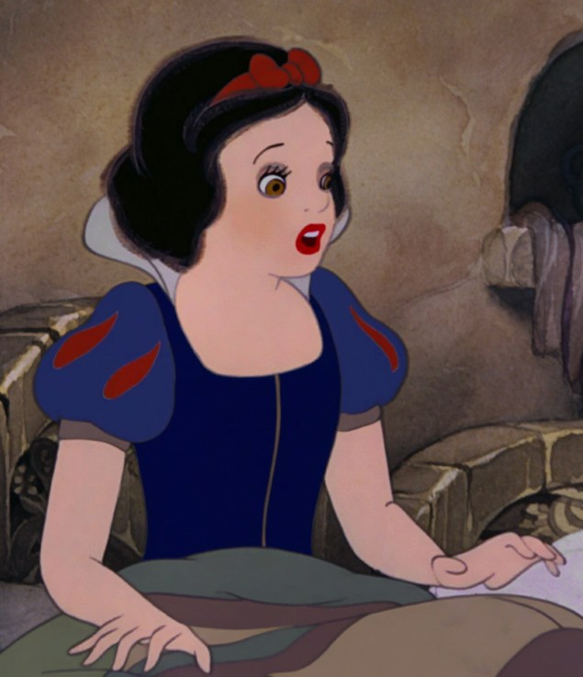
OUR PATIENT
3 WEEK OLD < 60 DAYS
NO
RECOMMENDATIONS!

Slide 20
SCALES OF SUSPICION
RULE IT OUT WORK IT UP

Slide 21
RESPIRATORY –
RSV
PERTUSSIS
ASPIRATION
FOREIGN BODY
AIRWAY ANOMOLY
RULE IT OUT WORK IT UP

Slide 22
GI
GER
MALRO
INTUSS
RULE IT OUT WORK IT UP

Slide 23
ID
UTI
SEPSIS
MENINGITIS
RULE IT OUT WORK IT UP

Slide 24
CARDS
ANEMIA
CHD
ARRYTHMIA
RULE IT OUT WORK IT UP

Slide 25
NEURO
SZ
NAT
RULE IT OUT WORK IT UP

Slide 26
METABOLIC / TOX
INBORN ERROR
TOX
RULE IT OUT WORK IT UP

Slide 27
IDIOPATHIC
RULE IT OUT WORK IT UP

Slide 28
WHO IS THE FAIREST ONE OF ALL?
SNEEZY
GRUMPY
DOC
BASHFUL
DOPEY
SLEEPY
HAPPY
RESPIRATORY
GI
ID
CARDS
NEURO
METABOLIC
IDIOPATHIC
GER
MALRO
INTUSS
RSV
PERTUSSIS
ASPIRATION
FOREIGN BODY
AIRWAY ANOMOLY
UTI
SEPSIS
MENINGITIS
ANEMIA
CHD
ARRYTHMIA
SZ
NAT
INBORN ERROR
TOX

Slide 29
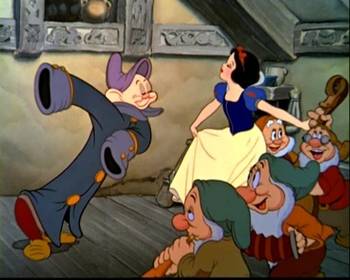
NEXT STEP?

Slide 30
WORKUP
CBC3, BMP, UA - WNL
Ucx and Pertussis PCR - pending
RSV - neg
EKG - sinus
When to get other tests:
CXR – respiratory symptoms
EEG – if sz suspected
CT, skeletal survey, fundoscopic exam – if abuse suspected
pH probe – frequent reflux
ECHO/Holter – murmur/arrhythmia heard
LP, cultures, CRP – fever, possible sepsis
Utox – suspected ingestion

Slide 31
Admit for Observation?

Slide 32
HOSPITAL COURSE
Overnight pt develops tachypnea, coarse breath sounds and has an episode of apnea for 30 seconds with desaturation to 70s. Resolved with PPV and 2L O2.
Additional Questions? Now what?

Slide 33

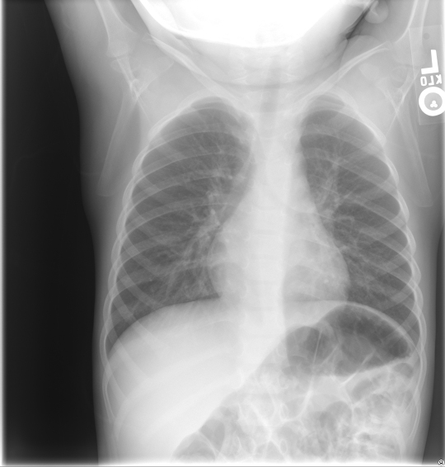

Slide 34
CASE RESOLUTION
Pt transferred to NICU, started on broad spectrum Abx, had several more apneic episodes and was intubated the following day.
Repeat CXR obtained prior to intubation.

Slide 35
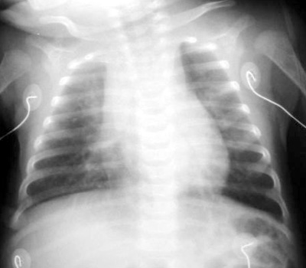

Slide 36
CASE RESOLUTION
Pertussis PCR positive
Extubated 3 days later and symptoms resolved
New protocol, NICU admission considered for all infants <30 days old presenting with apnea

Slide 37
CASE RESOLUTION
Pertussis PCR positive
Extubated 3 days later and symptoms resolved
New protocol, NICU admission considered for all infants <30 days old presenting with apnea

Slide 38
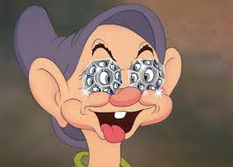
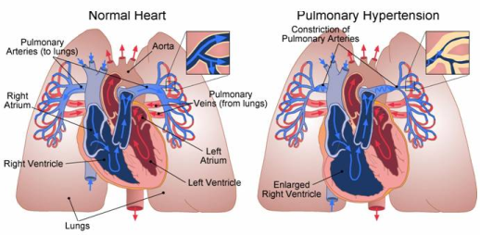
INFANTILE PERTUSSIS GEMS
- Paroxysmal cough and whoop uncommon
- Can present with apnea, pneumonia or seizure
- “Shaggy heart” sign on CXR
- Complication: Leukocytosis -> pulmonary HTN -> R heart failure
treated with double exchange transfusion / ECMO (70% fatal)

Slide 39
BRUE GEMS
Risk factors for underlying pathology–
prematurity, prior ALTE, post-conceptual age < 44 weeks,
lasting > 1min, not self resolving
If initial resuscitation required – inc suspicion for NAT
Not a precursor to SIDS

Slide 40
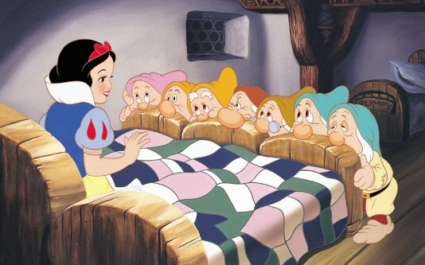
“Say please and thank you even if you’re feeling grumpy”
SNOW WHITE GEMS
“You’re never too old to be young”

Slide 41
PREP QUESTION
A 6-week-old infant is seen in the emergency department with congestion, cough, and gagging that is resulting in facial cyanosis. The infant was born at term to a healthy 25-year-old mother with appropriate prenatal care and negative prenatal laboratory studies for infection. The patient’s grandmother also has an illness characterized by cough. On physical examination, the infant’s temperature is 37°C, heart rate is 135 beats/min, respiratory rate is 50 breaths/min, and blood pressure is 70/50 mm Hg. The infant is well developed and well nourished. She has episodes of coughing and gagging as you examine her, and the oxygen saturation decreases from 95% to 88% on room air during these episodes. She has thick oral secretions (Item Q161A). The anterior fontanelle is soft, open, and flat. There is nasal congestion, but the conjunctivae, oropharynx, and tympanic membranes are unremarkable. The patient has coarse breaths sounds on auscultation, but there are no retractions. The remainder of the physical examination is unremarkable. The peripheral white blood cell count is 55,000 (55.0 × 109/L), with 20% polymorphonuclear neutrophils and 80% lymphocytes. The patient’s hemoglobin is 10 g/dL (100 g/L) and the platelet count is 260 × 103/µL (260 × 109/L).
Of the following, the test MOST likely to establish the patient’s diagnosis is a
A. bacterial culture on routine media
B. direct fluorescent antibody test
C. polymerase chain reaction test
D. test for specific immunoglobulin M
E. viral culture using specific media

Slide 42
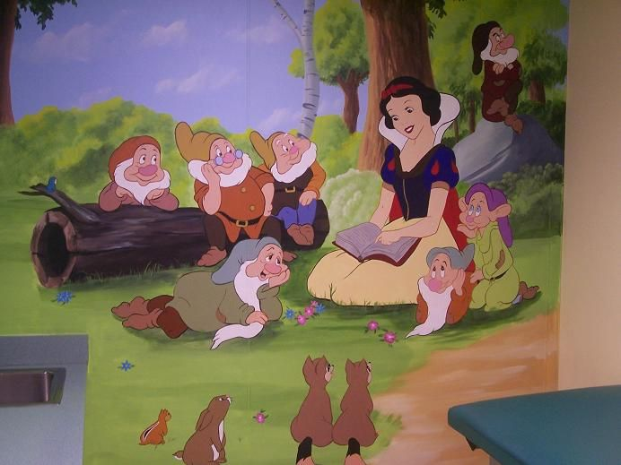
References
Brief Resolved Unexplained Events (Formerly Apparent Life-Threatening Events) and Evaluation of Lower-Risk Infants, Tieder et al, Pediatrics. 2016 Aug; 137(5)
Early infantile pertussis; increasingly prevalent and potentially fatalSmith C1, Vyas H.; Eur J Pediatr. 2000 Dec;159(12):898-900.
http://www.aap-ca.org/clinical/pertussis/pertussis_in_young_infants.html

Slide 43
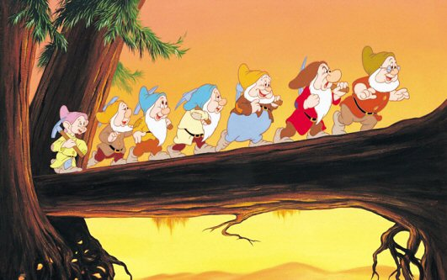
Heigh Ho, Heigh Ho, It’s off to work YOU go….

Slide 44
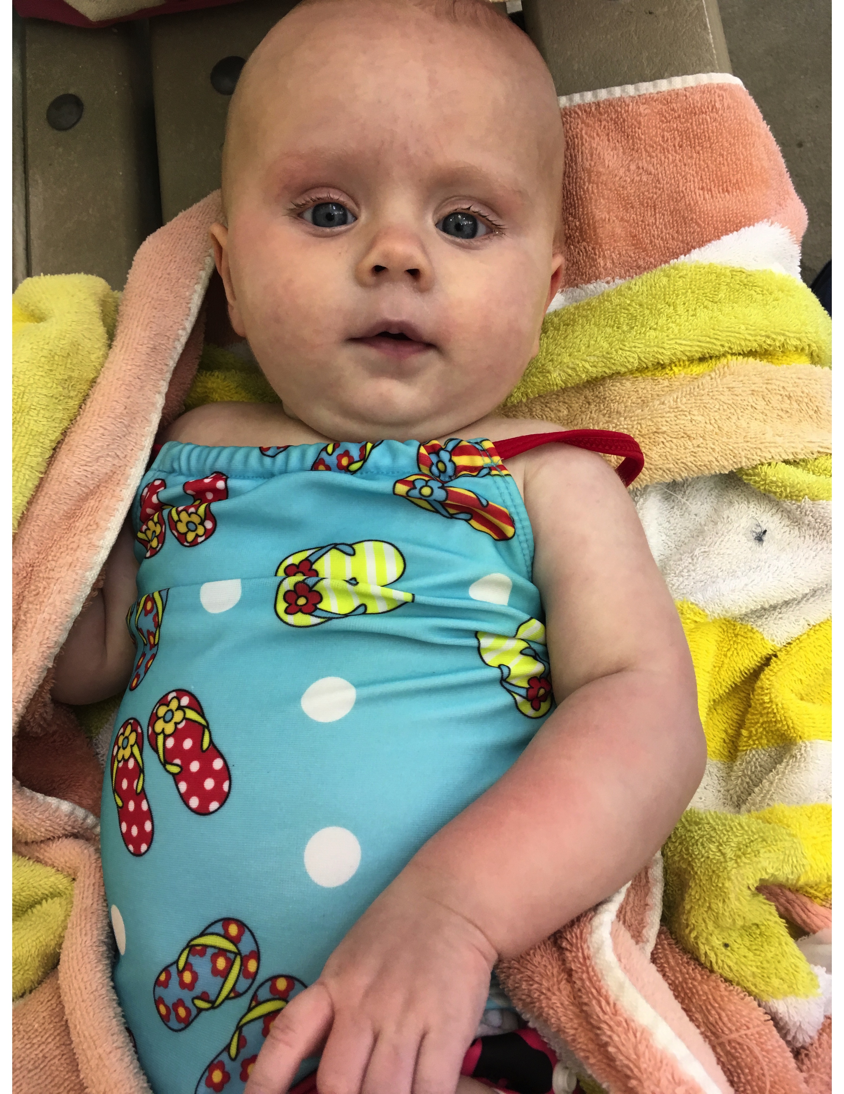
The
Eighth Dwarf
“POOPY”

